Slide 1
Web Search Engine
Turf Booking Platform…….
Group members: -
Ratan Singh- ( 9511 )
Aarush Wasnik- ( 9517 )
Guided by :- Prof. Archana lopes

Slide 2
INTRODUCTION
A web search engine that will be specifically used to book a turf at best deals.
Some insight: -
Compare various deals available on the turf.
Host various turf websites.

Slide 3
PROBLEM STATEMENT
Users are not able to avail the best-sorted deals according to their needs and pocket size at a one-stop platform.
In this rapidly developing world, the area available for outdoor activities has been reducing day by day. So, people prefer to book a play inside the turf. But the main problem faced by the sports enthusiast is that they don’t have enough resources or a single website where they can browse and book their favourite and best-offered deal to them without doing any manual work for a longer duration of time. So we decided to build a search engine that will be specifically used for sorting turf with their need.

Slide 4
Objective
To allow users to search and view information about Turf online using our search engine.
Using various filters (such as rating, amenities, and price range) as keywords to find the most accurate search result.
Using a sorting algorithm with condition term frequency of filter keyword.

Slide 5
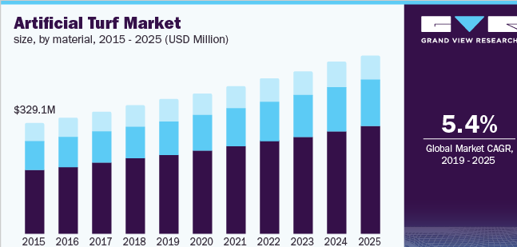
NEED FOR A SEARCH ENGINE
One stop platform where user can find the satisfactory output from the search engine.
Rising demand for the turf, but no application where user can compare the turf in term of space , price , ratings .
Global Artificial Turf Market 2021-2025:- The analyst has been Monitoring the artificial grass turf market and it is poised to grow by Rs 104 crore during 2021-25 progressing at the CAGR of over 5.45% during the forecast period.

Slide 6
Extensive LITERATURE SURVEY
Sr. No. | Title | Abstract | Advantage
1. | “Online Playground Booking System” | Online booking system and identification of the user by QR Scanning. | - Identification By QR Scanning.
2. | “ Design and Implementation of Online Booking System of University Sports Venues ” | Booking of Sports Venues inside the University where there is more than one sports venue. | Personal Care Modules. Message Board Function.
3. | “On The Design of Web-Based Information and Booking System For Futsal Field Rental Business” | Football Field Renting Application in which Football Field owners can promote their field. | - Google Map API.

Slide 7
RESEARCH GAP / PROBLEMS WITH EXISTING SYSTEMS
There are many websites that will help you book your desired turf, but going to various websites is a pain that currently does not have any impactful solution.
Also, in existing website there are many fluctuation in price for booking turf.
There is no application which provides the result in a sorted manner in terms of price, location, and amenities.

Slide 8
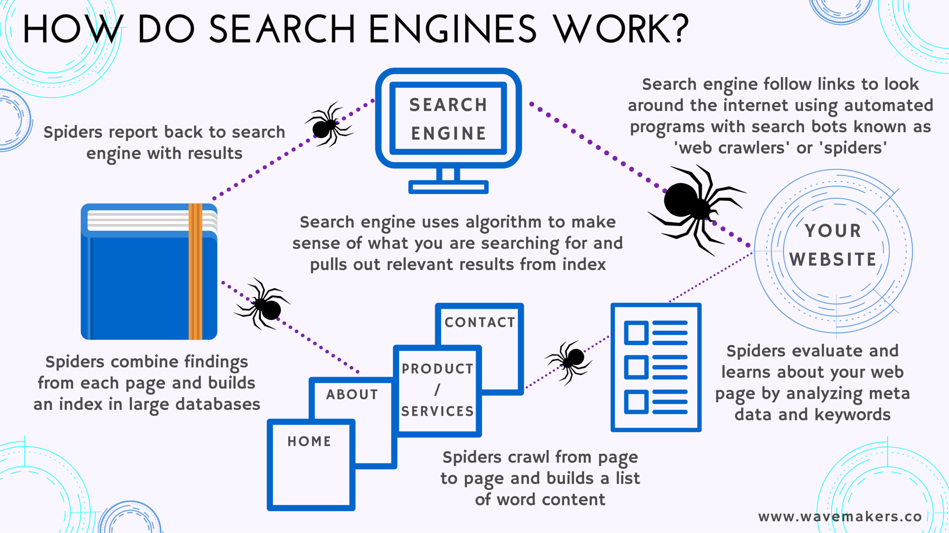
PROPOSED METHODOLOGY
The Search Engine works in the following Steps:-
Input ( Query) from User.
Crawl → Web Spider.
Index.
Ranking Algorithm.
Shows Output.

Slide 9
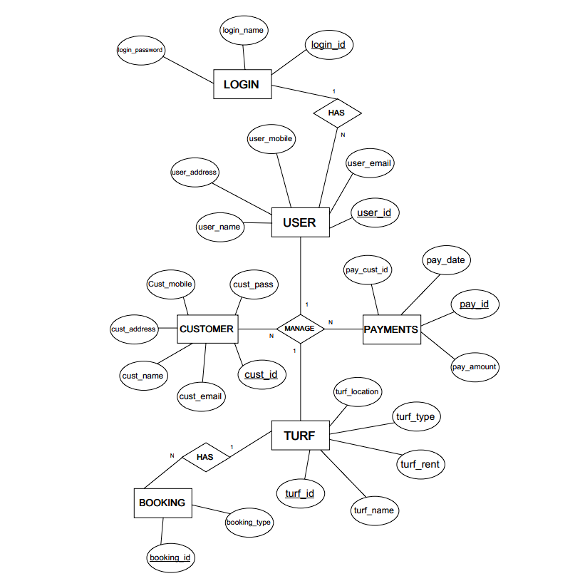

Slide 10
INNOVATIVENESS IN PROPOSED SOLUTION
The facility of a Search Engine for specifically booking a playground is not available in the current area of the turf booking system.
A search engine with various filters will help find the accurate result based on the need in terms of price, location, and amenities.
An application that will sort all the existing websites of turf and will show the best deal for the user.

Slide 11
Software requirement
Frontend: -
Backend: -
HTML
CSS
NodeJS
ExpressJs
MongoDB

Slide 12
References
Resources:-
Google Scholar
Web Technologies used by Trivago.be (w3techs.com)
YouTube
GeeksforGeeks | A computer science portal for geeks
Research Paper:-
https://nihb.ac.in/admin/uploads/questionbank/bc6c49d1-4dff-4cd6-8137-e567d1398cc91633534502428344331.pdf
(PDF) Design and Implementation of Online Booking System of University Sports Venues (researchgate.net)
On The Design of Web-Based Information and Booking System For Futsal Field Rental Business | PDF | Android (Operating System) | Mobile App (scribd.com)

Slide 13
Thank you!

